Slide 1


Insurance Fraud Detection

Slide 2



Project Overview
Executive Summary
Objective
Model Selection
Deployment
Detect fraudulent insurance claims using machine learning.
Multiple models evaluated; Decision Tree performed optimally after tuning.
Model deployed via a Flask application, providing a user-friendly HTML interface.
This project successfully leveraged machine learning to create an automated system for identifying fraudulent insurance claims, significantly improving efficiency over traditional manual methods.

Slide 3

Problem Statement: The Cost of Fraud
Insurance fraud poses a substantial financial burden on the industry, leading to billions in losses annually. These costs are often passed down to policyholders through increased premiums.
Current manual detection processes are labor-intensive, time-consuming, and prone to human error, making it difficult to keep pace with the sophistication of fraudulent activities.
Our Goal: Develop an intelligent, automated system capable of accurately identifying fraudulent claims in real-time, thereby mitigating financial losses and streamlining operations.

Slide 4

Dataset Overview: The Foundation of Our Analysis
Our analysis was built upon a comprehensive dataset of 1000 historical insurance claims, providing a rich source of information for pattern recognition.
Each claim was characterized by 40 distinct features, encompassing a wide range of data points:
Claim Amounts: Detailed financial figures related to the incident.
Customer Demographics: Anonymized information about the policyholders.
Incident Details: Specifics regarding the nature and context of each claim (e.g., collision type, property damage).
The target variable for our predictive model was fraud_reported, a binary indicator (Yes/No) that labels each claim as either fraudulent or legitimate.

Slide 5
Exploratory Data Analysis: Uncovering Patterns
Our initial EDA phase was crucial for understanding the dataset's characteristics and identifying potential indicators of fraud.
1
2
3
Imbalance Detected
Key Feature Insights
Visualizations Employed
A significant disparity was observed between fraudulent and non-fraudulent cases, requiring specific handling during preprocessing.
Features like claim amount and incident severity showed strong correlations with reported fraud, indicating their predictive power.
Correlation Heatmaps: To visualize relationships between all features.
Boxplots: For understanding feature distributions and outliers.
Countplots: To assess categorical feature distributions, especially fraud vs. non-fraud.
These visualizations provided critical insights, guiding our feature engineering and model selection processes.

Slide 6




Preprocessing & Feature Engineering Pipeline
Missing Value Handling
Categorical Encoding
Replaced '?' characters with standard NaN values to ensure proper data processing.
Applied Label Encoding to convert all categorical features into a numerical format suitable for machine learning models.
SMOTE for Imbalance
Feature Scaling
Employed Synthetic Minority Over-sampling Technique (SMOTE) to address the class imbalance, generating synthetic samples for the minority (fraud) class.
Used MinMaxScaler to scale numerical features, ensuring all values fall within a consistent range and preventing dominance by features with larger magnitudes.
This rigorous preprocessing pipeline was essential for preparing our data, ensuring it was clean, balanced, and optimized for effective model training.

Slide 7



Models Explored: A Comparative Approach
To identify the most robust solution for fraud detection, we evaluated a range of machine learning algorithms, each with its unique strengths.
Decision Tree
Random Forest
XGBoost
Selected as final model after extensive GridSearchCV hyperparameter tuning.
Ensemble method, prone to overfitting on this dataset.
Gradient Boosting, also showed signs of overfitting.
Logistic Regression
Stacking
Baseline linear model, provided a balanced but lower accuracy.
Combined top-performing models but did not yield significant improvement.
This thorough comparison allowed us to objectively assess each model's performance and generalizeability on our specific fraud detection task.

Slide 8
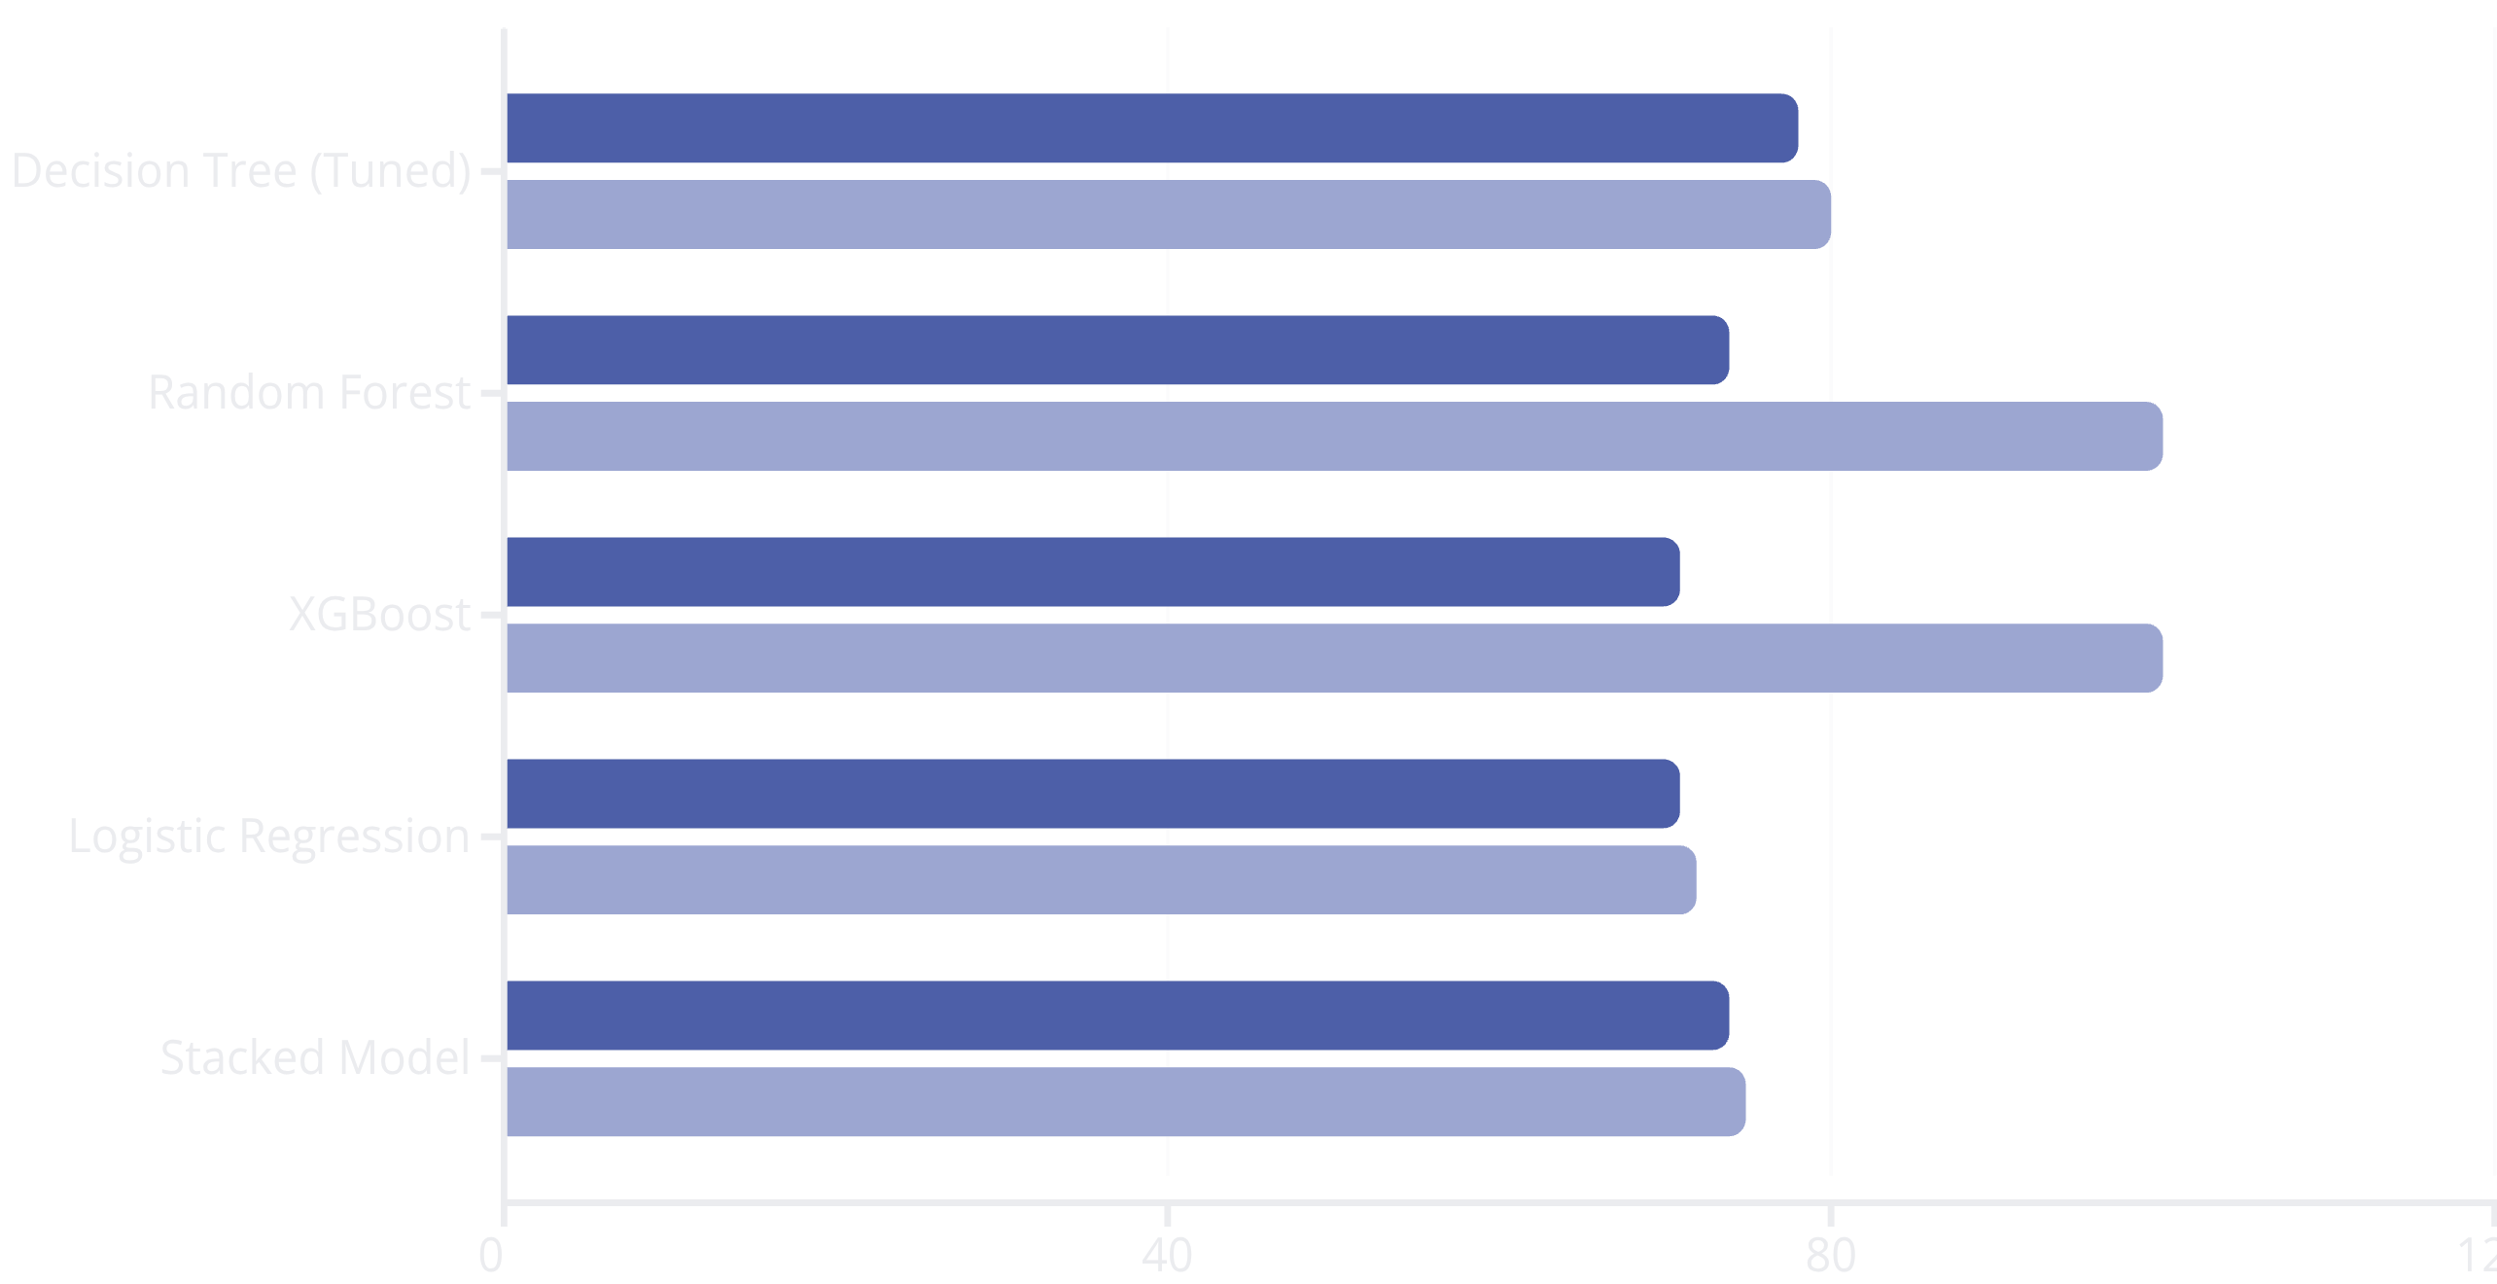
Model Performance: A Comparative Analysis
Test Accuracy
Train Accuracy
The chart above clearly illustrates the trade-off between training and test accuracy. While Random Forest and XGBoost achieved perfect training accuracy, their significantly lower test accuracy indicated strong overfitting. The Decision Tree, after tuning, demonstrated the best balance between training and test performance, ensuring robust generalization to new unseen data.

Slide 9

The Chosen Champion: Tuned Decision Tree
The Decision Tree Classifier emerged as the optimal model for this fraud detection task due to its superior balance of performance and interpretability.
Extensive hyperparameter tuning using GridSearchCV refined its performance, leading to the following optimal parameters:
criterion='entropy': Used for measuring the quality of a split, favoring more balanced trees.
max_depth=3: A constrained depth to prevent overfitting, ensuring the model remains interpretable and generalizes well.
min_samples_leaf=1: The minimum number of samples required to be at a leaf node.
min_samples_split=2: The minimum number of samples required to split an internal node.
This configuration allowed the model to capture underlying fraud patterns effectively without memorizing the training data, resulting in excellent generalization capabilities.

Slide 10
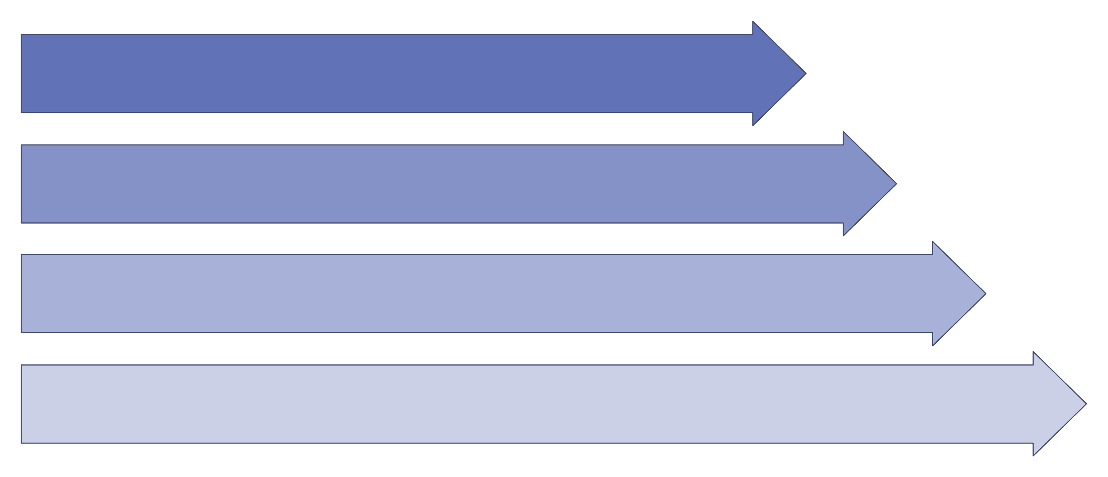
Deployment Architecture: Real-Time Predictions
User Input
Data Processing
Model Prediction
Result Display
The deployed system utilizes a lightweight Flask web application to provide a seamless interface for users. Claims details are submitted via a simple HTML form, processed by the backend model, and the fraud prediction is returned directly to the user, enabling immediate insights.

Slide 11



Recommendations & Future Work
Building on our successful fraud detection model, we've identified several key areas for further enhancement to maximize its effectiveness and ensure long-term robustness.
Data Enrichment & Scale
Advanced Model Exploration
Robust Monitoring & Logging
Integrate larger, more recent datasets to improve model accuracy and capture evolving fraud patterns. Continuous data ingestion is crucial for maintaining relevance.
Investigate sophisticated ensemble methods with pruning techniques to potentially boost performance while mitigating overfitting, building upon the Decision Tree's strengths.
Implement comprehensive logging and monitoring for the deployed model, enabling real-time performance tracking, anomaly detection, and ensuring operational stability.
These strategic recommendations aim to further strengthen our fraud detection capabilities, driving continuous improvement and greater financial security.

